Slide 1
Automated analysis pipeline overview
Language: Python
Files: CD3 subset from all donors
Pipeline: New and existing elements combined into a novel pipeline
All results are based on 30k per sample due to limitations of computing resources.
Final analysis will be performed on a full dataset using cloud computing (~£200).

Slide 2


This step will be created from scratch and will replace manual pre-processing (doublets, dead cells) and perform data artefact removal (instead of FlowAI)

Slide 3
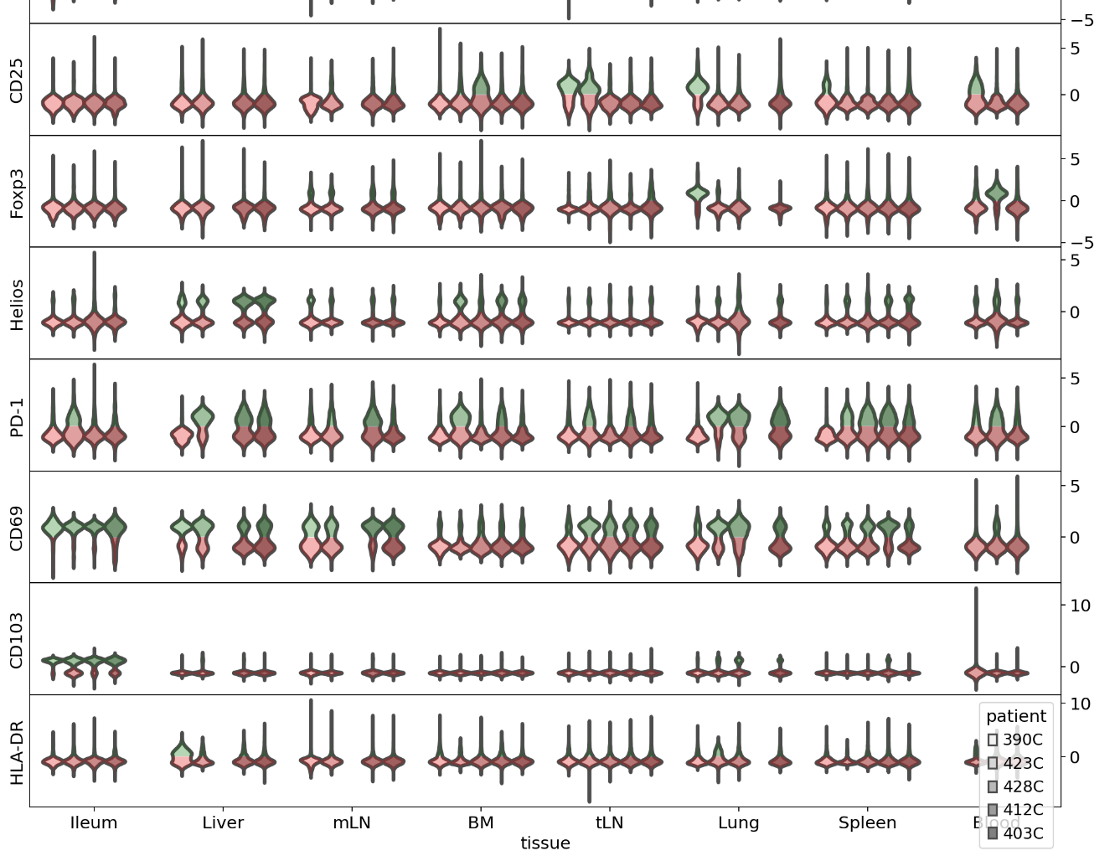
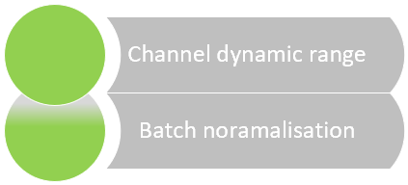
Negative/Positive populations are detected automatically for each channel and aligned+scaled individually to produced a normalised expression profile.

Slide 4
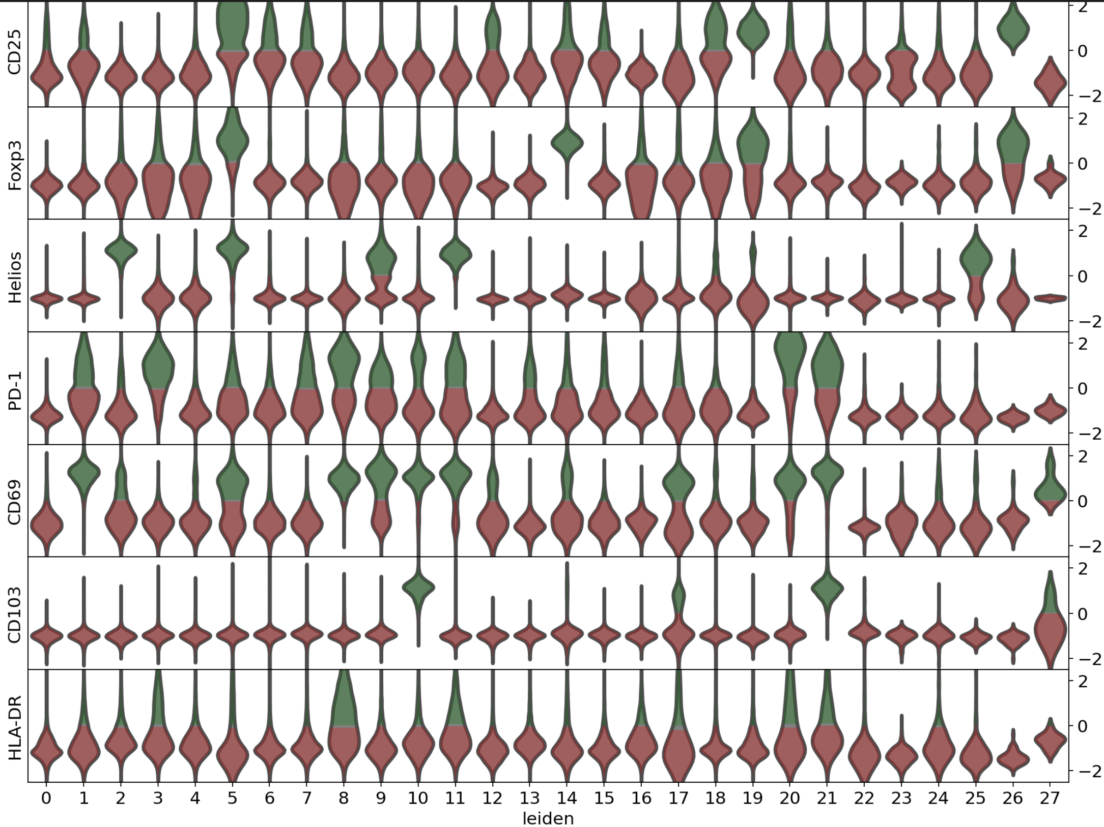
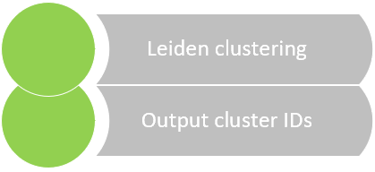
Visualisation of normalised marker expression per cluster across all tissues following Leiden clustering.

Slide 5
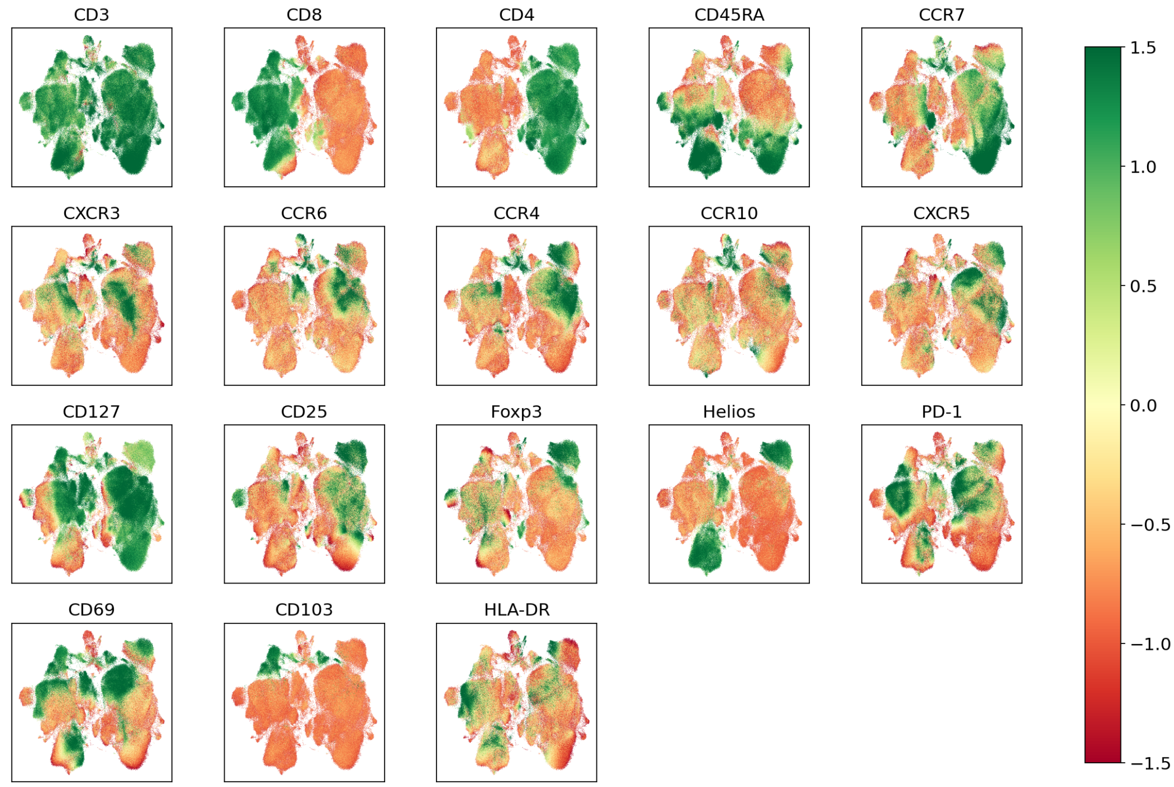
Visualisation of normalised marker expression per cluster across all tissues following Leiden clustering.

Slide 6
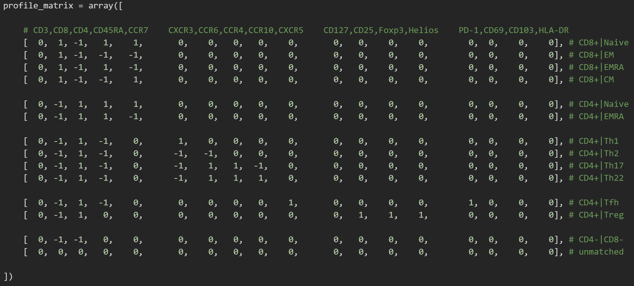
Population definitions
Mapping cluster IDs to annotations
A marker profile matrix that contains population definitions is used for automated annotation.

Slide 7
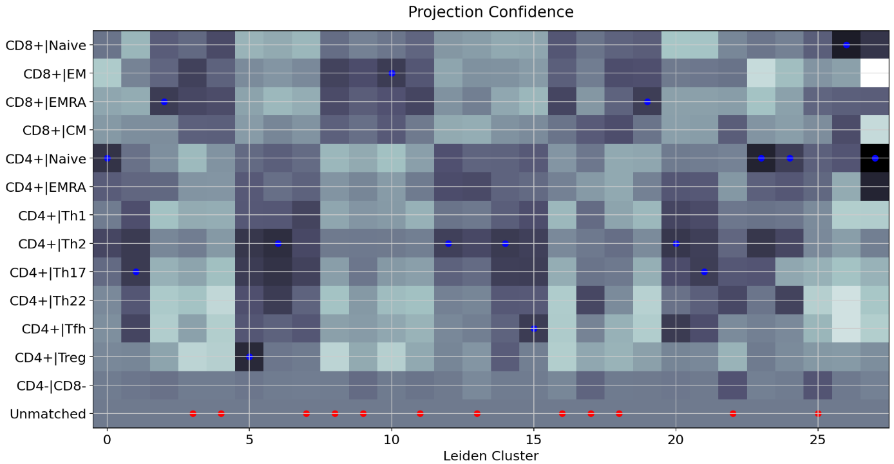
Confidence of annotations-to-clusters mapping
A confidence matrix is used to set the cluster annotation confidence threshold

Slide 8
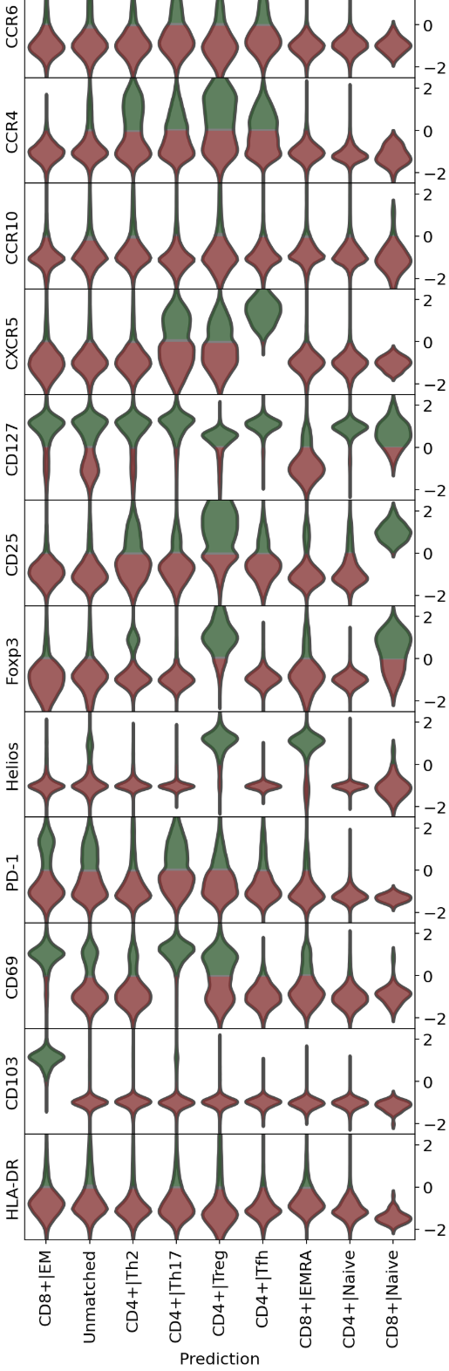
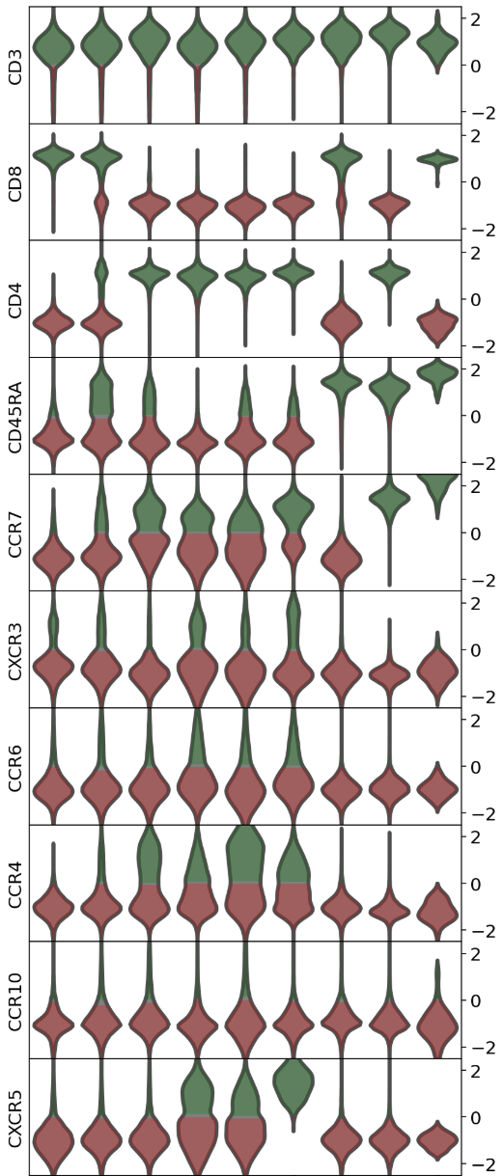
Using annotation confidence threshold, all clusters are merged based on their defined cell identity. Clusters with low confidence annotation are labelled as “Unmatched”.
Marker expression profile in each cluster can be inspected by eye.

Slide 9
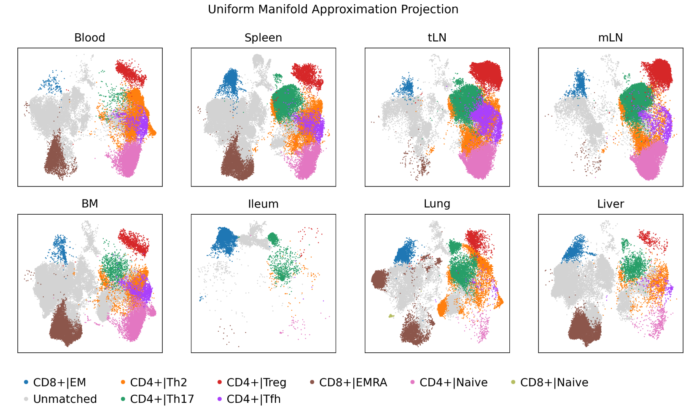
All clusters can now be visualised and compared by tissues.

Slide 10
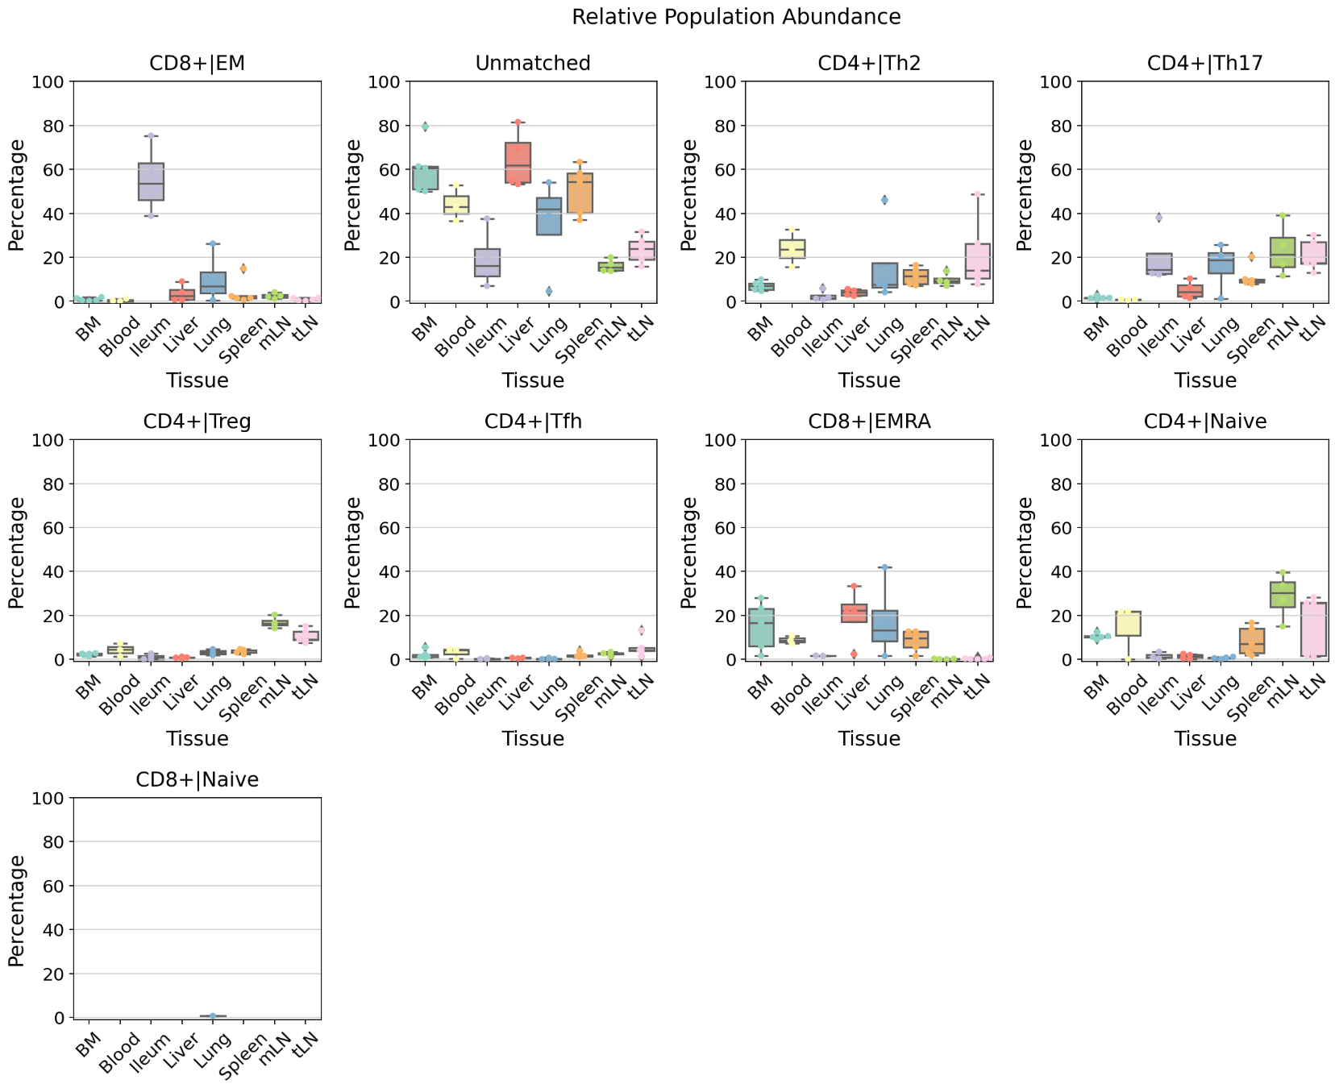
Any population statistics can be exported

Slide 11
Next steps
Fix 390C CD4 correction
Implement precision recall curve and set optimal confidence threshold for cluster annotation and merging
Finalise QC comparison of population frequencies for automated vs manual analysis using FJ GateML files
Run benchmarking experiments using other well-annotated datasets (from Zoya)
Look into a different batch normalisation approach for Zoya
Create data pre-processing module to replace manual doublet/live gating and data artefacts (replace FlowAI)

